Slide 1
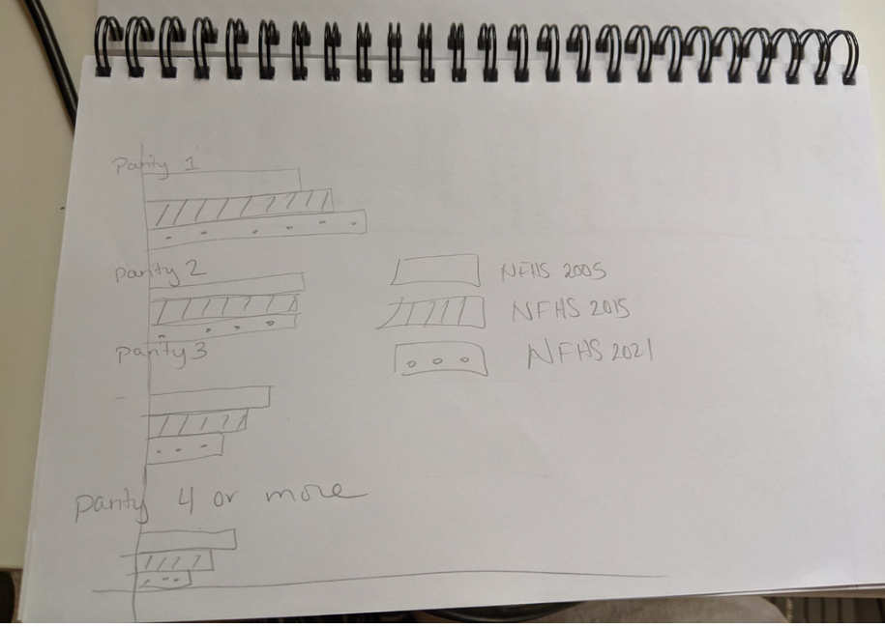
Among currently pregnant women 3+ months, what parity is the current pregnancy (among living children).
Remake using that pregnancy and any live births

Slide 2
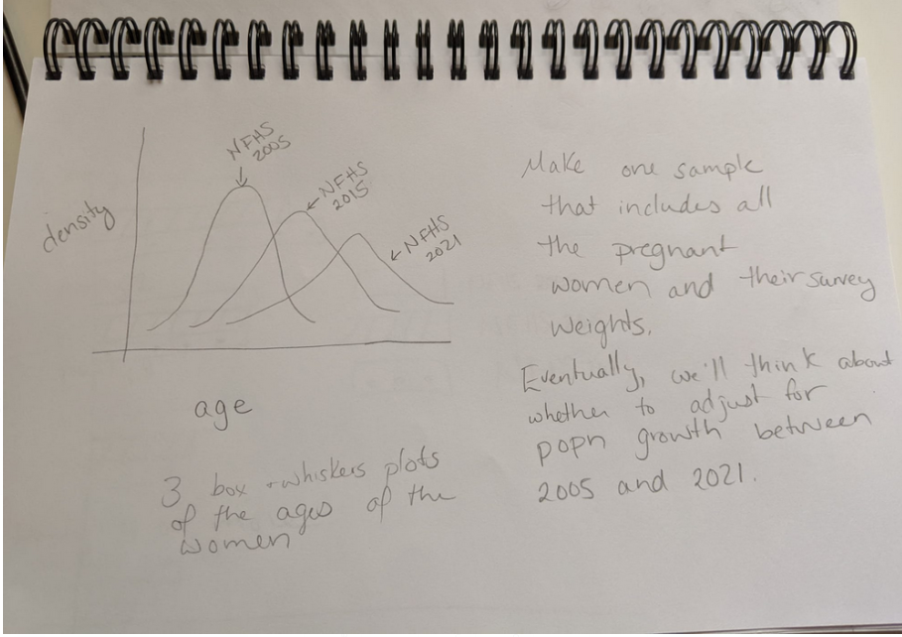

Slide 3
Ages of pregnant women: Things to include
Kdensities of ages of pregnant women (3+ mo preg) in each survey (use within survey weights)
Box and whisker plots of ages of 3+mo preg women in each survey (use w/in survey weights)
Number of 3+ mo pregnant women in each survey
Percent of women ages 15-49 who are 3+ mo pregnant at the time of the survey

Slide 4
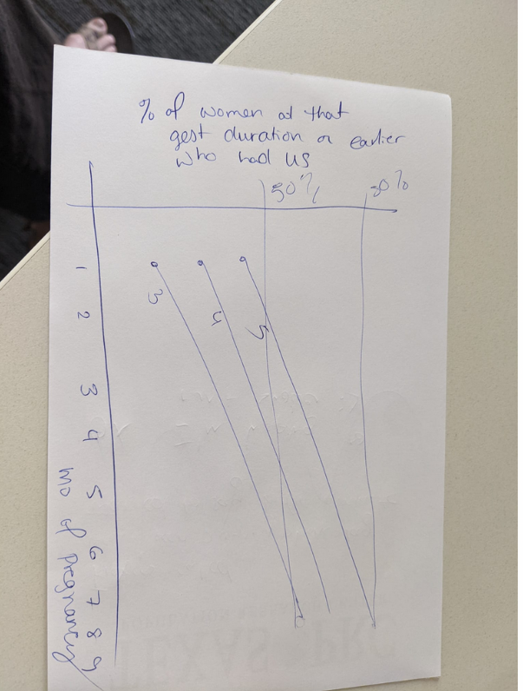

Slide 5
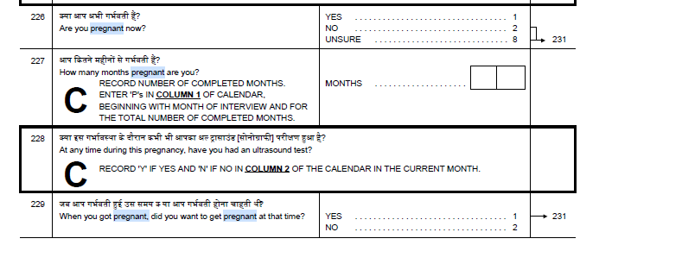
Other things
Among those who are pregnant now, and at each parity, how many wanted to become pregnant at that time.
By duration of pregnancy, CDFs of having had at least one ultrasound test in each of the three waves.
In each wave, how many had a period six or more months ago, are married, are not using contraception, and say they are “not pregnant or unsure” (see this)
How many people for whom v215>=6 is pregnant (v213) no or unsure?
Similarly could look at v215>=2, 3, 4, 5

Slide 6
Gestational duration in three rounds using months pregnant and months since last period
Make the table such that someone can compare months pregnant to months period within the same round, and months pregnant across the different rounds

Slide 7
Pregnancy wantedness/timing
Main question: Make a table that shows
Within each survey round, what proportion of currently pregnant women reported wanting the current pregnancy at that time
By parity (defined as living children plus current pregnancy) what fraction report wanting the pregnancy at that time
By month of pregnancy, what proportion of currently pregnant women report wanting the pregnancy at that time (can you make confidence intervals for this proportion – I think they may overlap).
Sanity/reasonableness checks:
What proportion of currently married, not pregnant women are using a modern method of contraception (or are sterilized) in each of the following groups:
With no living children
With no living boys
Those who say they want no children or no more children
For fun: look through the Women’s Questionnaire and see whether you can identify any other questions that might tell us about pregnant women’s mental health.

